Slide 1
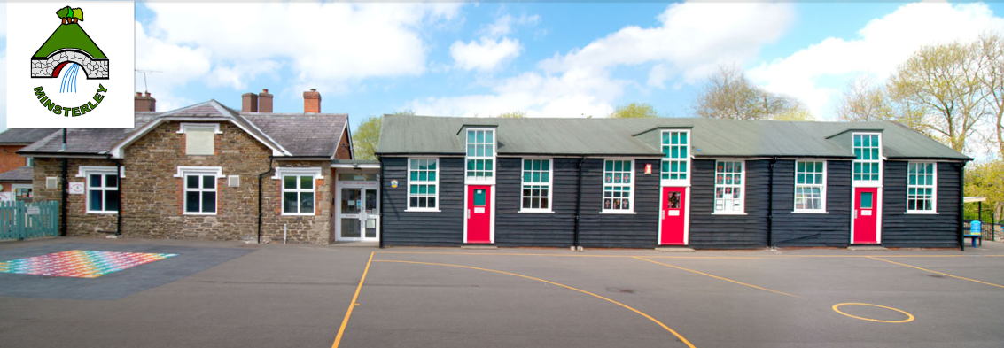
SEND at Minsterley

Slide 2
INTENT STATEMENT
Aims
At Minsterley Primary School we believe that learning is a change to long term memory. We intend to create knowledge through spaced repetition and backwards and forwards learning. Our curriculum is built around repeated opportunities to strengthen key concepts. This suits our children with SEND very well as our primary area of need is Cognition and Learning - Specific Learning Difficulties. Fundamental to this is a positive culture where needs are understood and mistakes are treated as opportunities.

Slide 3
The SEND coordinator (SENCo) at Minsterley Primary is Mrs Mel Ward, working Mondays and Tuesdays and the SEND Governor is Mr Steve Jones.

Slide 4
How we identify and assess SEN at Minsterley.
We identify children through discussions and observations and screeners. We consult parents, TAs and teachers to gain a whole picture.
We follow a process of assess- plan-do-review tracking changes and patterns and trying various recommended strategies.
All children in school are discussed at termly pupil progress meetings and any changes in progress or other concerns will be noticed.
If need be, the Senco will refer to speech therapy, occupational therapy, Woodlands Outreach Service, the Educational Psychologist or BEE-U for the neurodivergent pathway.

Slide 5
Who do we put on the SEN Register?
We place a child on the SEN Register if they have additional needs to those normally provided for within the classroom programmes offered. It is very common for a child to have an intervention even if they are not on the SEN Register. We tend not to put the youngest on the SEN Register but use a watch and see approach whilst still providing them with many early interventions.

Slide 6
The SEN Register
Minsterley SEN Support
10%
National SEN Support
13%
Minsterley with EHCP
3%
National with EHCP
4.3%
Notes:
All data up to date as of 11.03.24

Slide 7
Areas of Special Need at Minsterley Primary- (by primary and secondary need)
Cognition and Learning: (10 children on Sen Support and 1 with an EHC plan)
Specific Learning Difficulties (SpLD)-(8) including dyslexia, dyscalculia or dyspraxia traits (and 2 MLD and 1 Severe LD- with EHCP)
Communication and Interaction: (5 children on Sen Support and 2 with EHC plans)
Including Speech, Language and Communication (SLCN) Difficulties and Social Communication issues (ASD)
Social, Emotional and Mental Health (SEMH): ( 4 children on Sen Support and 1 with EHC plan)
including anxiety and ADHD
Physical and Sensory: (2 children with EHC plans)
including cerebral palsy and glue ear
Notes:
All data up to date as of 11.03.24

Slide 8
Type of need of children on SEN Support
Primary SEN in rank order at Minsterley | Primary SEN in rank order, nationally
1. SpLD 2. SLCN 3. SEMH 4. MLD | 1. SLCN 2. SEMH 3. MLD 4. SpLD
Notes:
All data up to date as of 11.03.24

Slide 9
Types of SEN Support at Minsterley Primary 138 children on roll 18 children on SEN Register(13%) 14 on Sen Support (10%) 4 with EHCP (3%)
1. Cognition and Learning-Specific Learning Difficulties (SpLD) [8 children experience] but we have many others with high risk of dyslexia traits who are not needing to be on SEN Support.
( 5 as primary need; 3 as secondary need)
including dyslexia traits; dyscalculia traits and dyspraxia traits
2. Speech, Language and Communication (SLCN)
[5 children experience]
( 5 as primary need)
1 as Social Communication and 4 as speech and language
3. Social, Emotional and Mental Health (SEMH) [4 children experience]
( 2 as primary need; 1 as secondary need)
1 as ADHD diagnosis; 2 as ADHD traits
We have many other children with SEMH needs who see our ELSA or have QFT in class and do not need to be on SEN Support
Notes:
All data up to date as of 11.03.24

Slide 10
Types of SEN of children with an EHC Plan at Minsterley Primary
We have 4 children with EHC Plans.
2 children in Reception:
1 child has severe learning difficulties and communication and interaction needs.
1 child has communication and interaction needs and physical needs
We have 1 child with an EHC Plan in Y1.
This child has communication and interaction needs and social and emotional needs
We have 1 child with an EHC Plan in Y3.
This child has cerebral palsy.

Slide 11
Provision for our new children with EHCPs
With new children with EHCPs in our Reception Class, staff have carried out training especially in speech, language and communication to support these children.
Attention and Listening
Use of Visuals
Information Carrying Words
Colourful Semantics
Makaton
They are making full use of this training and developing positive relationships with these children.

Slide 12
Notes:
EEF Summary of Recommendations for SEN in the mainstream primary school- 1. ready, respect, safe, training to calm and deregulate, encouraged to learn from ‘marvellous mistakes’. PCP, pupil progress, screeners, informal discussion.- staff and pupil voice 3. SEE charts for QFT with each need. 4. flexible groupings eg for same day intervention in all classes in maths, use of verbal feedback, 5. mainly keep in same class- able to do live marking as they watch teaching input etc

Slide 13
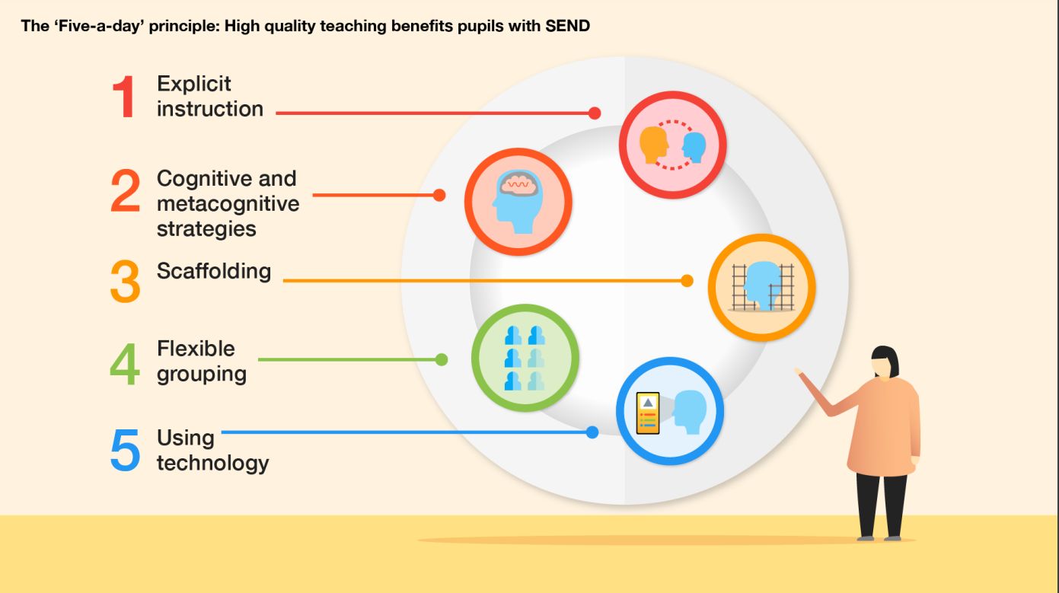
Notes:
EEF – 5 a day recommendations for QFT for SEN children. 1. explicit instruction – often going to child to check on track, individually prompted as needed, interventions in small flexible groups around misconceptions eg in maths eg for 5-10 mins often small group same day intervention and live marking- activitating prior knowledge eg with history threads using artifact regularly , trips based around our learning eg stone age trip 2. cognitive and metacognitive strategies- thinking frames- introducing- teaching children to plan- monitor-evaluate. Retrieval and pop quiz, revisiting vocab in each year , modelling input and then moving away to independent tasks eg in maths Y5 observed in Stiperstones as group near whiteboard then move to independent task- scaffolded on google chrome bookeg visual- artifacts 3. eg maths scaffolding- lots of visual representations- 5. Google Chrome as main way of working, smartboard- whiteboard maths have base 10 on tech,

Slide 14
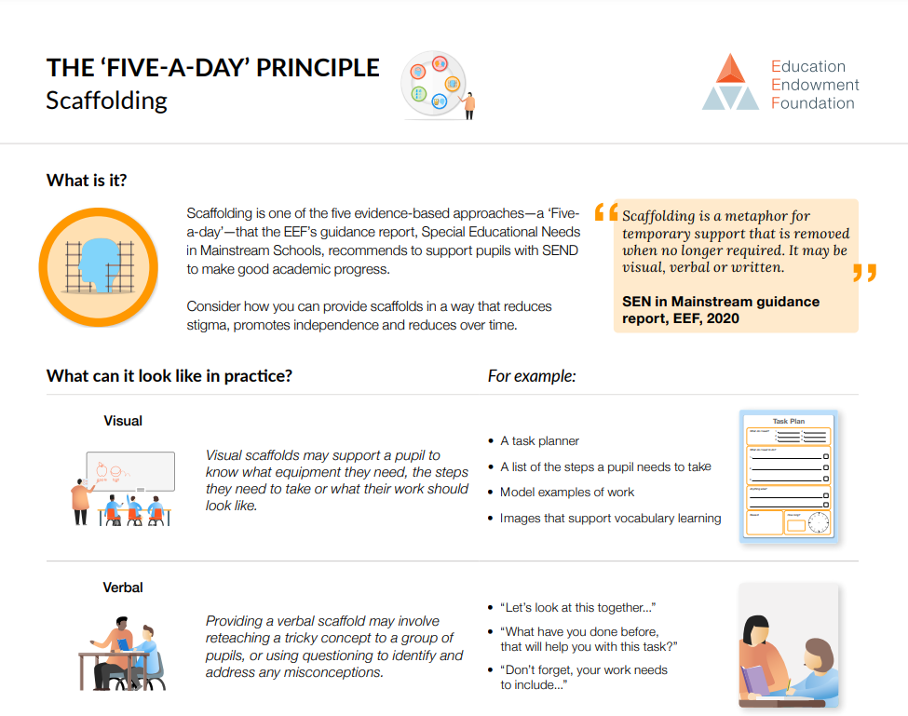

Slide 15
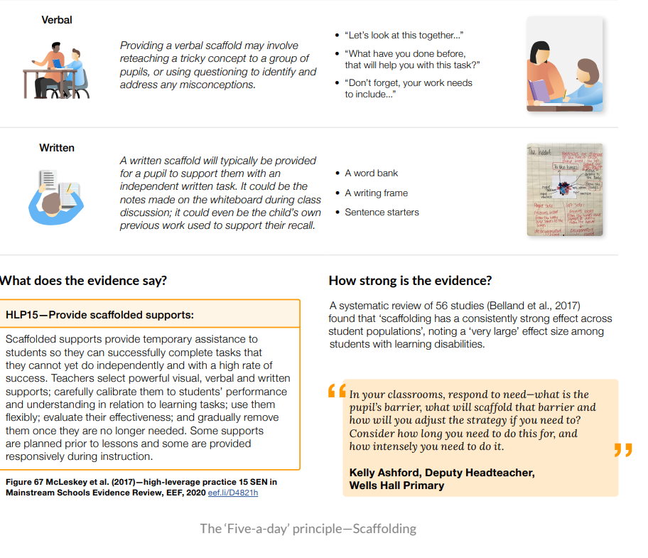

Slide 16
How our Curriculum is suited to the particular Special Needs of our Children at Minsterley Primary School
1. Specific Learning Difficulties (SpLD)
We aim for regular retrieval and repetition and prioritise consolidation of content over quantity of content. This is particularly appropriate for our children with specific learning difficulties.
We make our learning multisensory through varied approaches including in our phonics teaching and with our use of technology. Technology helps us with whole class teaching using scaffolding for example as part worked examples are presented to the children by powerpoint, along with our working walls that are actually used rather than simply displays. Technology and scaffolding are 2 strategies recommended for children with SEN by EEF. Children with SpLD benefit from the overlearning eg of TTRS, precision GPCs and phonics flashcards.
We widely use apps such as Spelling Shed and Nessy to give explicit training and multisensory practice in phonics and reading and spelling rules. We use screeners to try to pinpoint specific areas of difficulty such as auditory memory, visual sequencing, processing speed and many more dyslexic traits to try to offer support in our te2 aching.

Slide 17
How our Curriculum is suited to the particular Special Needs of our Children at Minsterley Primary School
1. Specific Learning Difficulties (SpLD)
Same day intervention is used for Maths to form flexible groupings. Flexible grouping is an EEF recommended strategy for children with SEN. This is alongside targeted interventions in number bond and times table recall and also mostly daily whole class NCETM teaching in all classes to overlearn key number facts and procedures. This particularly benefits our children with varied maths difficulties.
We have a positive culture that prioritises an environment where children are encouraged to take risks and learn from ‘marvellous mistakes.’ We use google chrome books and i-pads as our main way of recording. This provides a satisfying presentation format for children who would otherwise be demoralised by their handwriting and organisation. Gross and fine motor skills are not neglected though and are practised in Cool Kids and Funky Finger interventions for example.

Slide 18
Minsterley Provision for our Children’s Area of Needs – QFT – 1. Specific Learning Difficulties
Scaffolding and Visual Representations
Check on track
Retelling instructions
Thinking frames and metacognition (plan-monitor-evaluate)
Overlays and Reading Rulers
Considering cognitive load
Retrieval and overlearning
NCETM whole class teaching
Manipulatives
Explicit instruction
Assistive tech
Multisensory where possible

Slide 19
Minsterley Provision for our Children’s Area of Needs – Interventions- 1. Specific Learning Difficulties
Literacy
Nessy
GPC precision grids
1:1 Reading
Jelly and Bean and flashcards
Phonics Essentials

Slide 20
Minsterley Provision for our Children’s Area of Needs – Interventions- 1. Specific Learning Difficulties
Numeracy
Number bonds recall
Subitise
Times tables- TTRS and recall intervention
Power of 2- 1:1
Number Sense app
Flexible grouping- same day intervention

Slide 21
Minsterley Provision for our Children’s Area of Needs – Interventions- 1. Specific Learning Difficulties
Dyspraxia
Typing and assistive tech
Handwriting
Funky fingers
Cook Kids

Slide 22
How our Curriculum is suited to the particular Special Needs of our Children at Minsterley Primary School
2. Speech, Language and Communication (SLCN) Difficulties and Social Communication issues (ASD) and
3. Social, Emotional and Mental Health (SEMH):
We prioritise understanding a child’s underlying needs and deregulating challenging behaviour. Staff give much time to listening to children 1:1 and trying to understand and explore together how to help individuals with patterns of anxiety or behaviour. This might involve supervising play time, a special pass to see an adult to deregulate or chunking their time into specific purposes.
We try to use clear and explicit instruction. This is extremely important for our children with Social communication and interaction needs and social, emotional and mental health issues.
Our children also have access to a rolling programme of varied 1:1 ELSA work and to interventions such as Zones of Regulation or 3 positives an evidence-based intervention to encourage a more positive outlook.

Slide 23
Minsterley Provision for our Children’s Area of Needs – QFT- 2. Speech, Language and Communication
Clear and explicit instructions
Talking partners
Modelling
Whole class vocab reminders
Processing and thinking time
Thinking frames and Metacognition (plan-monitor-evaluate)
Visual Timetable
Visuals
Calm approach and aiming to help regulate
Now and Next Board
Makaton
Attention Bucket approach

Slide 24
Minsterley Provision for our Children’s Area of Needs – Interventions- 2. Speech, Language and Communication
1:1 speech and language therapy
ELSA for social communication
Free pass to an adult to help deregulate during unstructured time
Colourful Semantics
Zones of Regulation
Talkboost

Slide 25
Minsterley Provision for our Children’s Area of Needs – QFT- 3. Social, Emotional and Mental Health
Movement break- eg special jobs and heavy work
Chunking of unsupervised time
Special jobs and roles
Prompting
Calm approach and aiming to help regulate
‘marvelous mistakes’
Awareness of cognitive load
Thinking Frames and metacognition (plan-monitor-evaluate)
Visuals
Key trusted adult
Personalised curriculum to transition

Slide 26
Minsterley Provision for our Children’s Area of Needs – Interventions – 3. Social, Emotional and Mental Health
3 positives of the day (evidence-based to encourage positive outlook)
1:1 with ELSA
Free pass to an adult to help deregulate during unstructured time
Zones of Regulation

Slide 27
How our Curriculum is suited to the particular Special Needs of our Children at Minsterley Primary School
4. Physical and Sensory Needs:
cerebral palsy and glue ear
A physiotherapist trains key staff to support our children and carry out the necessary regular exercises in their school day.
For glue ear, we are aware that hearing can be intermittent especially during cold weather and so we are training our children to work in both a busy classroom, listening out for information carrying words and also more intensively 1:1 in a quiet area.

Slide 28
How our Curriculum is suited to the particular Special Needs of our Children at Minsterley Primary School All SEN Children
We have recently had staff training by Thinking Matters and are starting to introduce these visual metacognitive approaches to help our children organise their thinking and to explicitly teach them how to plan, monitor and evaluate their learning independently.
The EEF recommends metacognitive approaches for children with SEN.

Slide 29
Examples of how we ensure QFT happens
We focus on high quality QFT so that our children with SEN access as much as possible from whole class teaching.
Some ways we do this:
Identified Needs and Informed Staff:
Class Summary PCPs have QFT that is particularly relevant to each child on SEN register so all staff working with that child are informed.
We use screeners and gap analysis to pinpoint strengths and weaknesses eg Dyslexia Screener shows working memory issues, visual strengths and weaknesses, difficulty with auditory memory and also processing speed.
Awareness of barriers including social and emotional ones.
Aware of need to calm and deregulate for a child to be in any position to learn
Staff training eg Attention and Listening, Use of Visuals, Makaton, Information Carrying Words, Contrastive Pairs, Colourful Semantics, Cool Kids, Thinking Matters- Metacognitive Training

Slide 30
Examples of QFT in Minsterley
We make lessons as multisensory as possible so senses are engaged in learning- hearing, seeing, doing, moving… (eg. use of video and smartboard, apparatus, visuals…)
Retrieval practice is important for children with SEN as often need more overlearning to move to long term and have more barriers to overcome
Scaffolding
Offering apparatus and gradually encouraging independence of children getting what they need to help them eg number lines, sound mats,
Encouraging ‘marvelous mistakes’ and rewarding effort to build confidence and resilience
Chunking for listening
Getting some children to retell instructions
Whiteboards for notes so as not to overload working memory
Breaking down tasks into smaller steps
Giving extra thinking time and returning later to ask the child
Use of visual representations in maths that is consistently used through school
Visual timetables referred to as needed
Now and Next boards for adult-led activities
Questioning that is targeted to support particular children’s next steps
Prompting to keep on task

Slide 31
Examples of QFT in Minsterley
Where possible, checking understanding after instructions given so child does not go off at a tangent
Apparatus to give sensory feedback where needed eg wobble cushions, chewing necklace, blue tac in pocket
Reading rulers to avoid skipping lines in text, and overlays for visual stress
Reading aloud and scribing for some children
Guided reading to encourage fluency
Handwriting tools- slopes, pen grips and special pens
Assistive Tech- use of typing as daily way of working and to produce well-presented motivating work
Apps- TTRS- recall, overlearning
Nessy – video strategies to make phonics and spelling rules explicit for children who do not absorb it naturally
Spelling Shed-
Children are taught to explicitly visualise as they read as appropriate
Recently adopting thinking frames. Great for children with SEN to have thinking explicitly shown and modelled.
Use of other peers to model, talking partners…
Use of working walls to model and scaffold strategies
Attention drawn to new vocab
Child is usually able to easily access work from younger year work within the class (especially as mixed year groups)

Slide 32
Maths – QFT- examples
Using programmes and approaches that are good practice for SEN children- White Rose and NCETM- with small steps of learning and also misconceptions broken down clearly and presented visually and cumulatively
Use of working walls to model and scaffold strategies
Use of visual representations in maths that is consistently used through school
Making journey from concrete to abstract visual (NCETM approaches)
Offering apparatus and gradually encouraging independence of children getting what they need to help them eg number lines, sound mats,
Retrieval practice is important for children with SEN as often need more overlearning to move to long term and have more barriers to overcome- reminding them during day as possible
We make lessons as multisensory as possible so senses are engaged in learning- hearing, seeing, doing, moving… (eg. use of video and smartboard, apparatus, visuals…)
Child is usually able to easily access work from younger year work within the class (especially as mixed year groups)

Slide 33
History – QFT- examples
Use of visual symbols and common language through threads that are revisited regularly and in each class eg artifact - Great for children with SEN to build up visual connections and learn vocab
Opportunities for general knowledge and connections made to shine- so verbally drawn out beyond literacy ability eg OG in Lawley
Referring to class trip related to the subject that all have experienced so part of episodic memory and multisensory

Slide 34
Interventions in Autumn 23- In KS 1
AUTUMN 23 INTERVENTIONS
KS | Class | Year | Subject | Topic | Intervention | Number of Children
KS1 | 1.Clee | Y1 | Gross Motor | Cool Kids | Group | 4
EYS | 1.Clee | EHCP | Sp & Lang | Multiple | one to one | 2
KS1 | 1.Clee | Y1 | English | Reading | one to one | 2
EYS | 1.Clee | Y1 | English | Jelly and Bean | one to one | 1
KS1 | 2.Wrekin | Y2 | Maths | Subitise & bonds | Recall | 4
KS1 | 2.Wrekin | Y2 | English | Reading | one to one | 2
KS1 | 2.Wrekin | Y1 | English | Reading | one to one | 3
KS1 | 2.Wrekin | Y2 | English | GPCs | Precision Grid | 6
KS1 | 2.Wrekin | Y2 | English | Jelly and Bean | one to one | 4
KS1 | 2.Wrekin | Y2 | Fine Motor | Funky Fingers | Activities | 2
KS1 | 2.Wrekin | Y1 | Fine Motor | Funky Fingers | Activities | 2
KS1 | 2.Wrekin | Y1 | Sp & Lang | Targets | one to one | 1
KS1 | 2.Wrekin | Y2 | Sp & Lang | Storytell | Colour Semantics | 2
KS1 | 2.Wrekin | Y1 | Sp & Lang | Storytell | Colour Semantics | 2
KS1 | 2. Wrekin | Y2 | English | Phonics and Spell | Nessy | 3
KS1 | 3.Lawley | Y2 | Sp & Lang | Targets | one to one | 1

Slide 35
Interventions in Autumn 23- In KS 2
AUTUMN 23 INTERVENTIONS
KS | Class | Year | Subject | Topic | Intervention | Number of Children
KS2 | 3.Lawley | Y3 | Sp & Lang | Targets | one to one | 2
KS2 | 3.Lawley | EHCP | SEMH | Zones of Reg | one to one | 1
KS2 | 3.Lawley | EHCP | Physio | Exercises | one to one | 1
KS2 | 3.Lawley | Y3 | English | Phonics and Spell | Nessy | 6
KS2 | 3.Lawley | Y3 | English | Jelly and Bean | one to one | 3
KS2 | 3.Lawley | Y3 | English | Reading | one to one | 2
KS2 | 3.Lawley | Y3 | English | GPCs | Precision Grid | 3
KS2 | 3.Lawley | Y3 | Maths | Number bonds | Recall | 6
KS2 | 3.Lawley | Y3 | Maths | Timestables | Recall | 1
KS2 | 4.Stiperstones | Y5 | Maths | Timestables | Recall | 1
KS2 | 4.Stiperstones | Y4 | Maths | Timestables | Recall | 7
KS2 | 4.Stiperstones | Y5 | English | Phonics and Spell | Nessy | 10
KS2 | 4.Stiperstones | Y4 | English | Phonics and Spell | Nessy | 7
KS2 | 4.Stiperstones | Y5 | English | Reading | one to one | 6
KS2 | 4.Stiperstones | Y4 | English | Reading | one to one | 1
KS2 | 4.Stiperstones | Y4 | English | Jelly and Bean | one to one | 4
KS2 | 4.Stiperstones | Y5 | English | GPCs | Precision Grid | 2
KS2 | 4.Stiperstones | Y4 | English | GPCs | Precision Grid | 4
KS2 | 4.Stiperstones | Y5 | Sp & Lang | Targets | one to one | 1
KS2 | 5.Long Mynd | Y6 | Maths | Number | Power of 2 | 1
KS2 | 5.Long Mynd | Y5 | Maths | Timestables | Recall | 1
KS2 | 5.Long Mynd | Y6 | English | Phonics and Spell | Nessy | 11
KS2 | 5.Long Mynd | Y5 | English | Phonics and Spell | Nessy | 3
KS2 | 5.Long Mynd | Y6 | SEMH | Outlook | 3 positives | 1
KS2 | 5.Long Mynd | Y5 | SEMH | Outlook | 3 positives | 1

Slide 36
How we organise our SEN System at Minsterley?
PCPs and QFT needs are identified in the Summer Term and the new teacher plans interventions and sets up intervention grids with the help of the Senco ready to be up and running for the new year or term.
Intervention Grids with entry and exit assessment, track small steps of progress
These feed into our termly pupil progress meetings where the cycle begins again.
The Senco monitors classroom QFT and intervention and observes and talks to children, advising on next steps and resources especially with EHCPs.
The Senco works with parents both to gain a whole picture and to support the family. She signposts to services and family friendly workshops and activities and makes referrals.

Slide 37
Example PCP with QFT
Child Name SEN Support (SLCN), phonics, confidence | Interventions: (A) Regular reader, (B)speech therapy plan, (C) 1:1 vowel intervention and GPC precision grid (D) Nessy and Writing Beach
QFT - pen grip, lots of 1:1 chat, talking partner, understand cards, visuals, thinking time, vocab support, avoid copying from board, HFW/phonics flashcards, visuals, prompt to show maths workings out, recall phonics and not guess use lonely vowel and vowel friends to read vowels turn up the volume praise for attempts ensure others quiet for focus | Priority Focus of Intervention: Phonics- Daily 1:1 precision grid for GPCs Spot and use lonely vowel and vowel friends to decode accurately 1:1 x weekly Sp and Lang Intervention | Sp and Lang Therapy advise: To recall at least 4 items in order of mention with at least one adjective eg ‘bring the ball then the hoop then all the small beanbags’ To speak in a louder voice To use past tense sound in -ed words.
Talking Target To make comments to my talking partner and other children in a small group. | Reading Target I can use my phonics and ‘one lonely vowel’ and ‘vowel friends’ to decode words whenever I read. To complete Writing Beach and 50% of Nessy. To learn my phonemes: Ph2: p, b Ph3: oo, ow, ear, air, ure Ph5: ou, oy, ph, au, c, -y, al | Next Steps: To make connected comments to children in the playground.

Slide 38
Example Intervention Grid
GPC Precision Teaching Intervention | Entry data July 23 Phonic Screen (PS) Phonemes to learn % known | Mid term data End of Oct ‘23 | Exit data: End of Term Dec 23 | Comments: Good progress Identified issue Strategy to target this
Child 1 | Ph2: Ph3: Ph5: ou, ie, ea, oy, aw, wh, ew, au, i-e, u-e, c (50%) 11 to learn PS: 10
Child 2 | Ph2: Ph3: Ph5: ay, ou, ie, ea, oy, ir, ue, aw, wh, ph, ew, au, ey, i-e, u-e, c, al (23%) (17 to learn) PS: 16

Slide 39
SEN Action Plan 23 - 24
1. To ensure a clear and well planned out curriculum across school that ensures knowledge is transferred into long term memory for children with SEND.
Ensure QFT and interventions are taking place for children with SEND as agreed at pupil progress meetings. (QFT egs. and on PCPs)
EHCPS are accessible and broken down into small steps of learning for trained staff to easily deliver.
2. To ensure the steps of retrieval are having an impact in the subject to the children’s long-term memory.
Ensure interventions are multisensory where possible, create habits eg 3 positives, have chance for overlearning and review and are building systematically in small cumulative steps.
Use of early screeners and intervention where long term memory is not happening well

Slide 40
SEN Action Plan 23 - 24
3. To maintain a constructive relationship between school and parents so that parents can be supported to understand the part they play in reinforcing a positive attitude to learning at home.
Communicate to parents the importance of home support of school learning -routine, memory work to motivate, promote learning, executive function, organisation and emotional regulation,
Shared scripts between home and school, school rules…
PCP Meeting with Parents instead of on paper. Apply Metacognitive training to share ‘connecting factor’ thinking frame of home support with child progress- idea to start to introduce and embed gradually

